Slide 1



SAP-1
Computer Organization & Architecture Lab Project
BY:
Ali Asghar (21PWCSE2059)
Suleman Shah (21PWCSE1983)
Shahzad Bangash (21PWCSE1980)
Muhammad Shahab(21PWCSE2074)

Slide 2

Introduction:
The SAP-1 (Simple As Possible-1) computer architecture serves as an excellent educational tool for understanding the fundamentals of computer architecture and organization. This project involves implementing the SAP-1 architecture in Verilog.

Slide 3
SAP-1:
The SAP-1 (Simple As Possible-1) serves as an entry-level model for understanding fundamental concepts of computer architecture.
It consists of various modules, including a clock, program counter, registers, adder, memory, instruction register, bus, and controller.
It provides a hands-on approach to learning the principles of computer organization and operation.
This project is made with the help of Austin Morlan, you can check out his project in website given in references section [1].

Slide 4
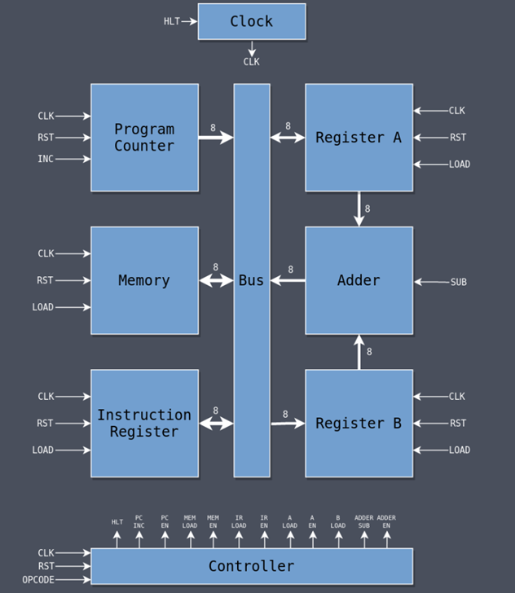
SAP-1 All Modules:

Slide 5
Tools Used:
Verilog:
A hardware descriptive language which we used to write code for SAP-1.
Model Sim[2]:
A tool for simulation and debugging tool often used in the field of digital electronics and integrated circuit design.

Slide 6
SAP-1 Instruction Set:
[0000] LDA $X: Load the value at memory location $X into A.
[0001] ADD $X: Add the value at memory location $X to A and store the sum in A.
[0010] SUB $X: Subtract the value at memory location $X from A and store the difference in A.
[1111] HLT: Halt execution of the program.

Slide 7
SAP-1 Modules:
Clock
Program Counter
Register A
Register B
Adder
Memory
Instruction Register
Bus
Controller

Slide 8
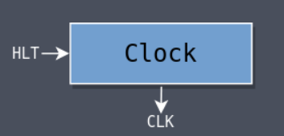
Clock Module:
Generates the clock signal for the system and includes a mechanism to halt execution.
Inputs: halt and clk_in.
Output: clk_out.

Slide 9
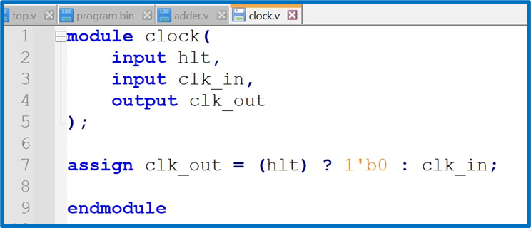
Code:

Slide 10
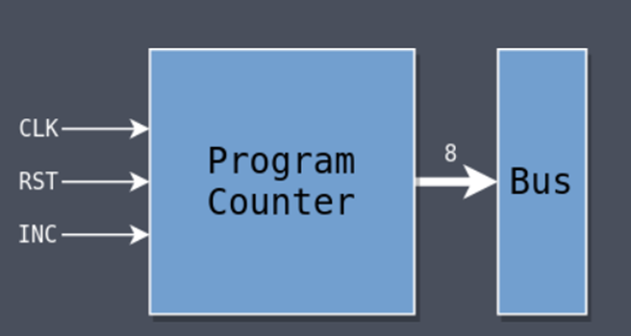
PC Module:
Keeps track of the memory address of the next instruction.
Inputs: clk (clock), rst (reset), inc (increment).
Outputs: out (current program counter value).

Slide 11
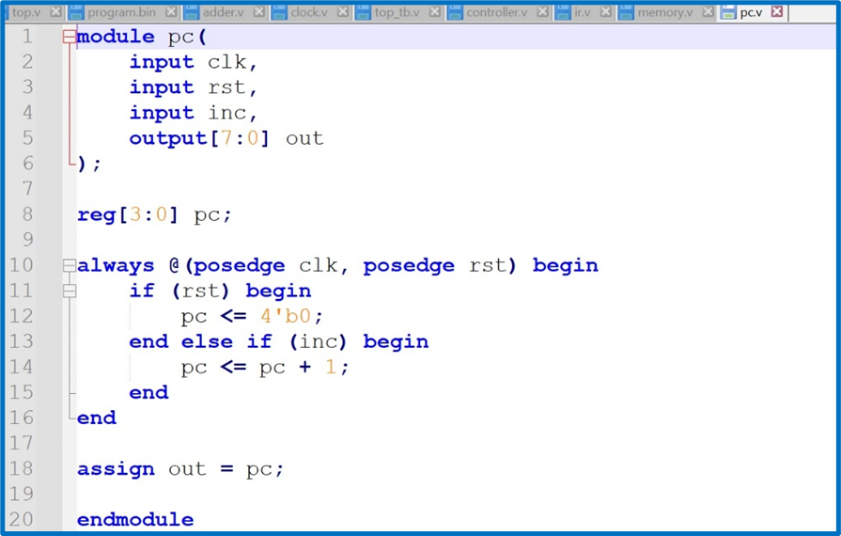
Code:

Slide 12
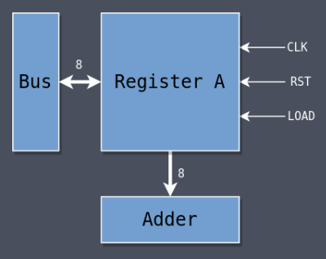
Register A:
Primary register for storing data also known as accumulator.
Inputs: clk (clock), rst (reset), load (load data), bus (data from bus).
Outputs: out (data stored in Register A).

Slide 13
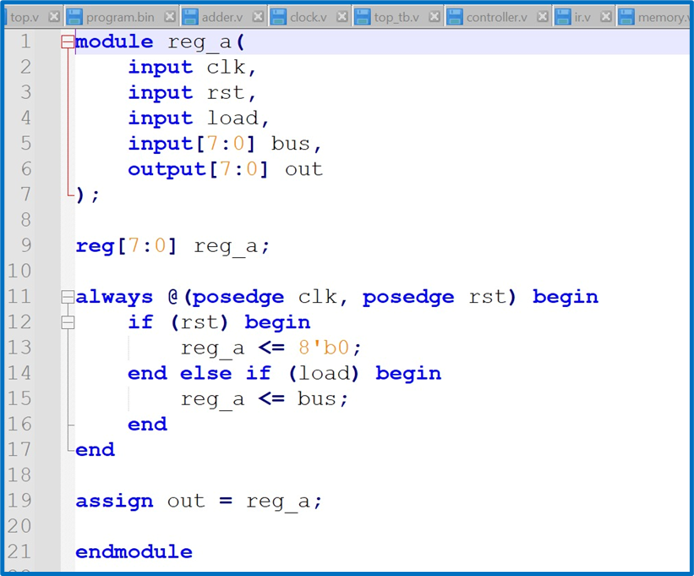
Code:

Slide 14
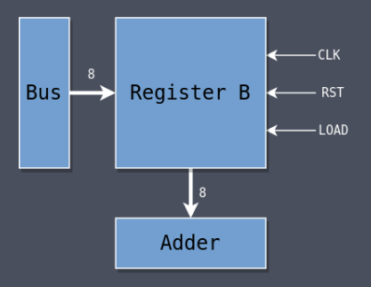
Register B:
Register B is identical to Register A in design but when it is used, it never drives the bus directly, its output is fed to the Adder only
Inputs: clk (clock), rst (reset), load (load data), bus (data from bus).
Outputls: out (data stored in Register B).

Slide 15
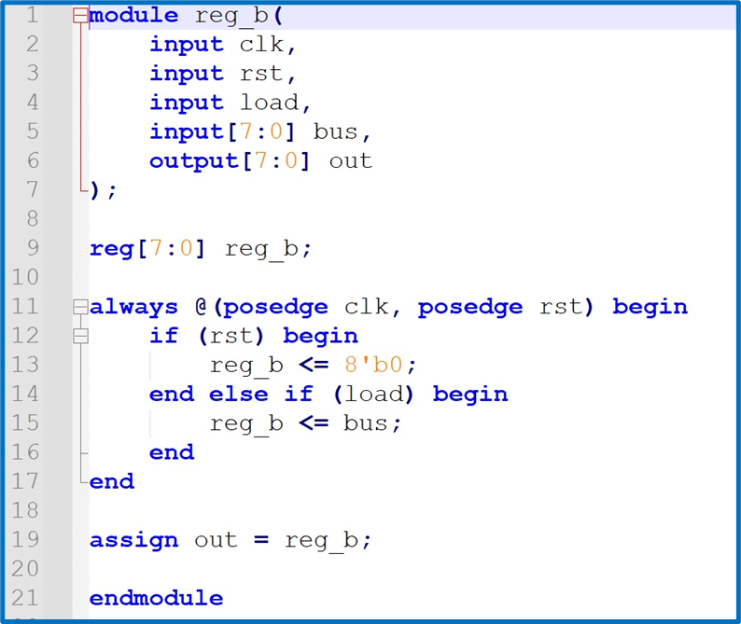
Code:

Slide 16
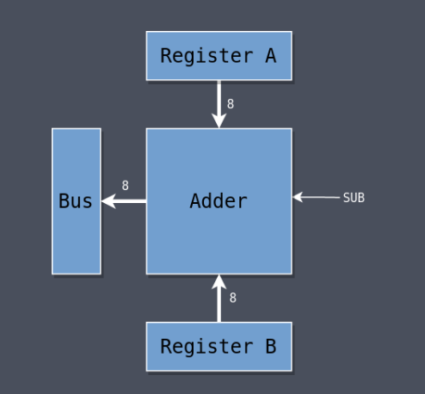
Adder:
Performs addition and subtraction operations.
Inputs: data from reg A and B, sub (subtraction signal).
Outputs: out (result of addition/subtraction)

Slide 17
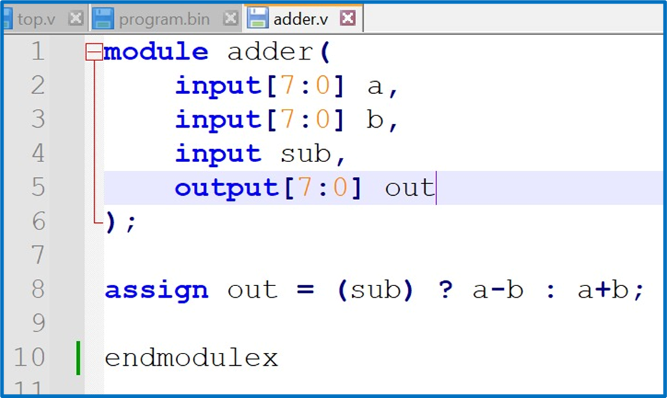
Code:

Slide 18
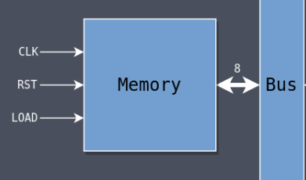
Memory:
Represents the RAM of the computer.
Inputs: clk (clock), rst (reset), load (load memory address), bus (data from bus).
Outputs: out

Slide 19
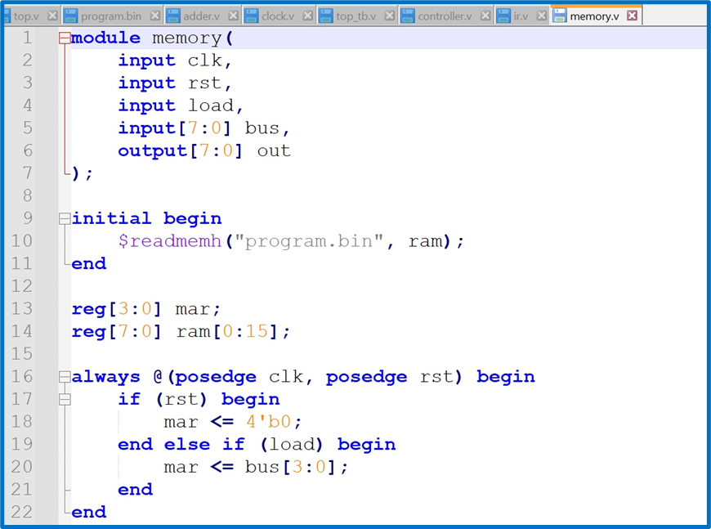
Code:

Slide 20
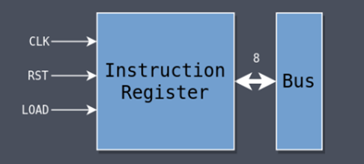
IR:
Decodes the current instruction.
Inputs: clk (clock), rst (reset), load (load instruction), bus (data from bus).
Outputs: out

Slide 21
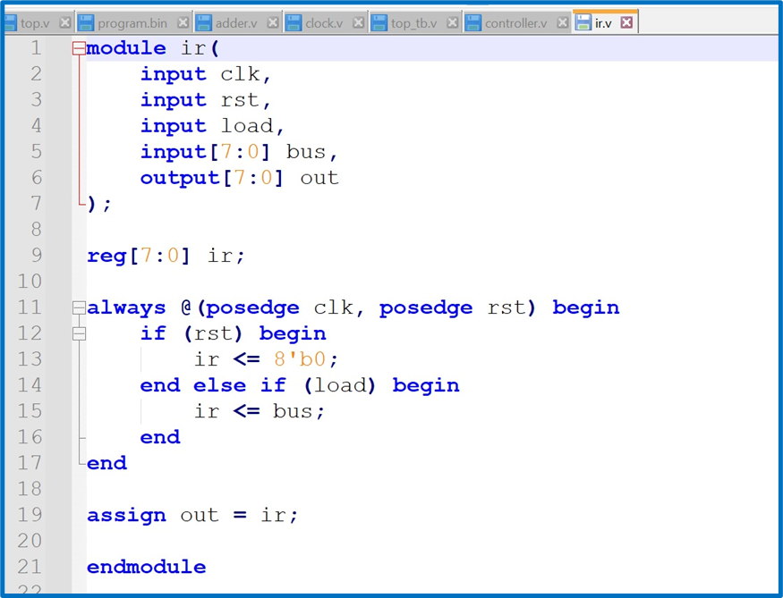
Code:

Slide 22
BUS:
Facilitates data exchange between modules.
Inputs: ir_en, adder_en, a_en, mem_en, pc_en (module enable signals).
Outputs: bus (data on the bus).

Slide 23
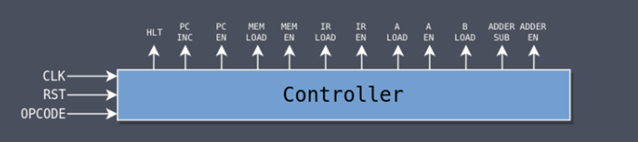
Controller:
Controls the behavior of the computer based on the instruction and stage.
Inputs: clk (clock), rst (reset), opcode (instruction opcode).
Outputs: Various control signals (hlt, pc_inc, pc_en, mar_load, mem_en, ir_load, ir_en, a_load, a_en, b_load, adder_sub, adder_en).

Slide 24
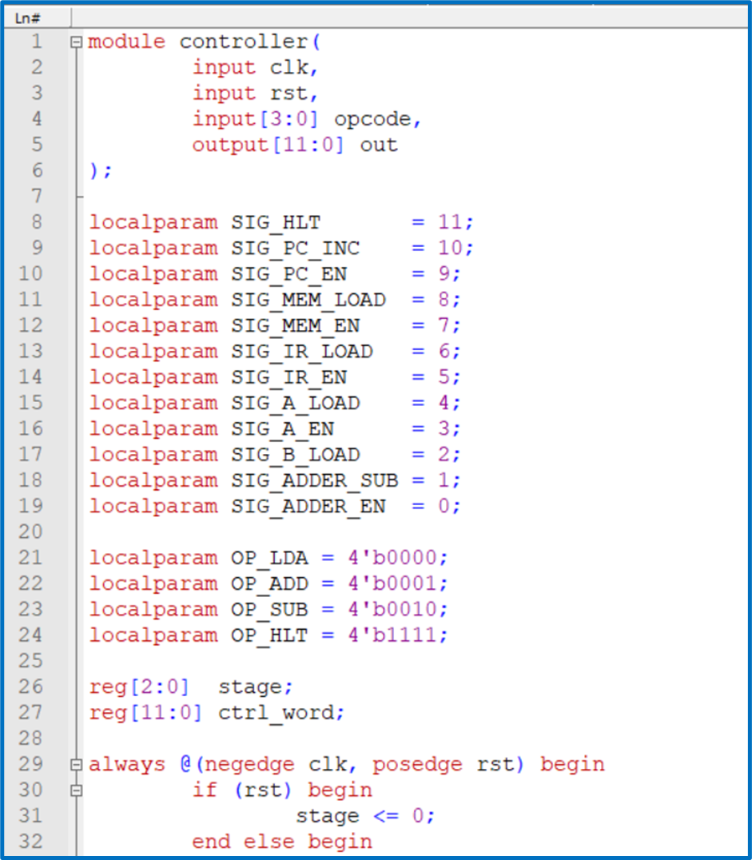
Code:

Slide 25
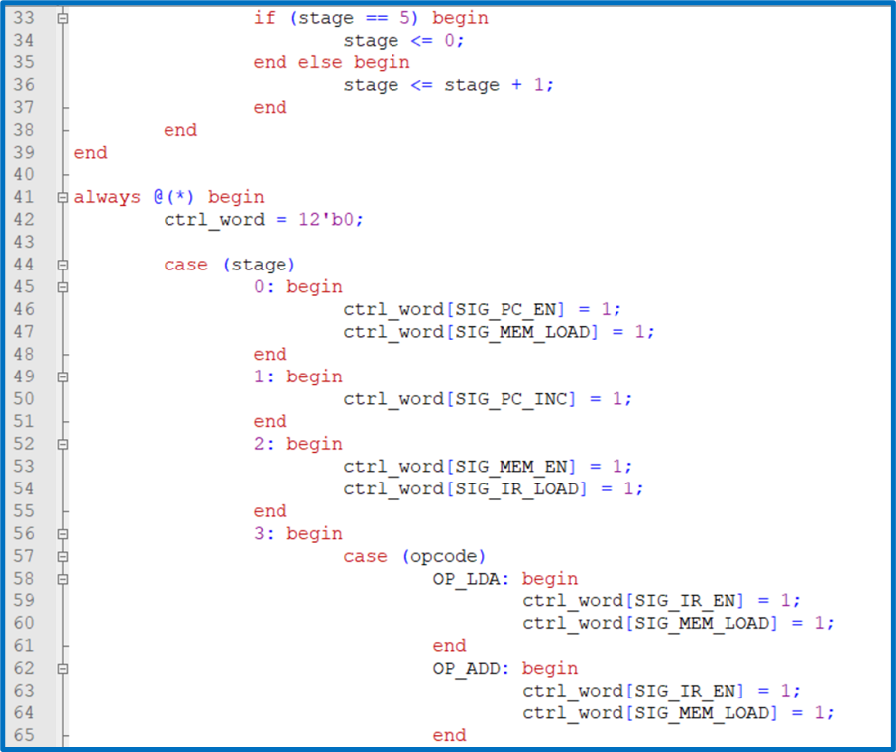
Code:

Slide 26
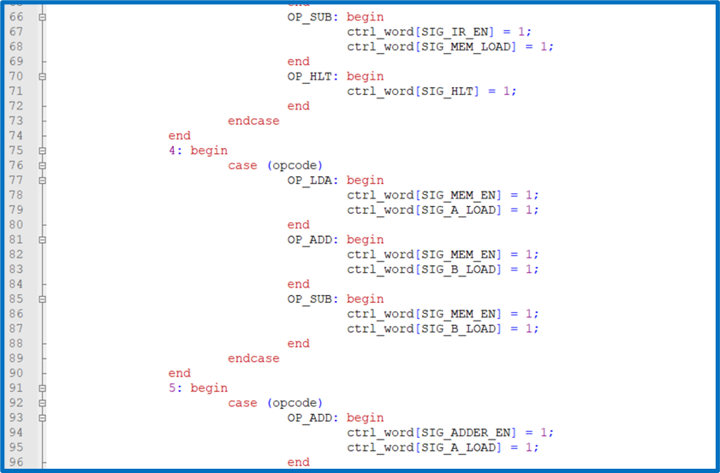
Code:

Slide 27
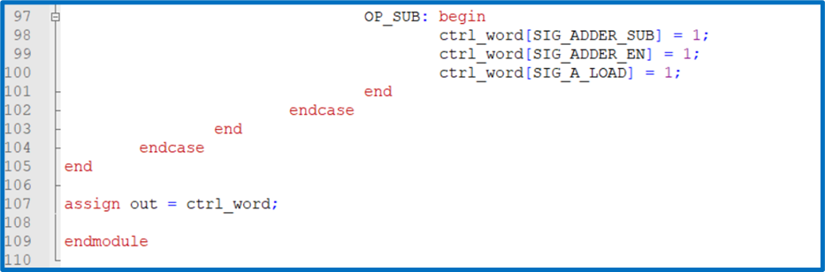
Code:

Slide 28
SAP-1 Operation
All Instructions have three stages same
Stage 0
Put the PC onto the bus (pc_en)
Load that value into the MAR (mar_load)
Stage 1
Increment the PC (pc_inc)
Stage 2
Put whatever is in memory at the MAR address onto the bus (mem_en)
Load it into the IR (ir_load)
After the first three stages, the actions performed during the next three differ depending on the instruction, and some of the instructions do nothing at all.

Slide 29
SAP-1 Operation
LDA Instruction:
Stage 3
Put the instruction operand onto the bus (ir_en)
Load that value into the MAR (mar_load)
Stage 4
Put whatever is in memory at the MAR address onto the bus (mem_en)
Load that value into Register A (a_load)
Stage 5
Idle

Slide 30
SAP-1 Operation
ADD Instruction:
Stage 3
Put the instruction operand onto the bus (ir_en)
Load that value into the MAR (mar_load)
Stage 4
Put whatever is in memory at the MAR address onto the bus (mem_en)
Load that value into Register B (b_load)
Stage 5
Put the value in the adder onto the bus (adder_en)
Load that value into Register A (a_load)

Slide 31
SAP-1 Operation
SUB Instruction:
Stage 3
Put the instruction operand onto the bus (ir_en)
Load that value into the MAR (mar_load)
Stage 4
Put whatever is in memory at the MAR address onto the bus (mem_en)
Load that value into Register B (b_load)
Stage 5
Do subtraction rather than addition (adder_sub)
Put the value in the adder onto the bus (adder_en)
Load that value into Register A (a_load)

Slide 32
SAP-1 Operation
HLT Instruction:
Stage 3
Halt the clock (hlt)
Stage 4
Idle
Stage 5
Idle

Slide 33
Simulation:
All the modules is tested in top testbench. It instantiates all of the modules in the computer and connects them to each other. The initial block at the beginning runs once at the start of simulation to create a file called top_tb.v which contains all of the simulation data.

Slide 34
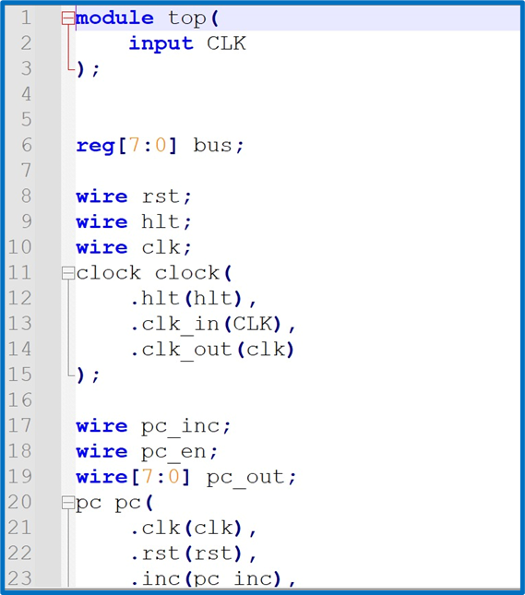
Code:

Slide 35
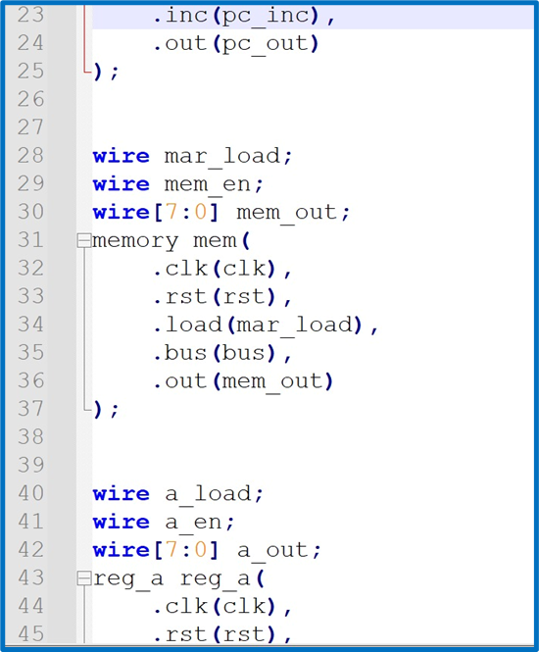
Code:

Slide 36
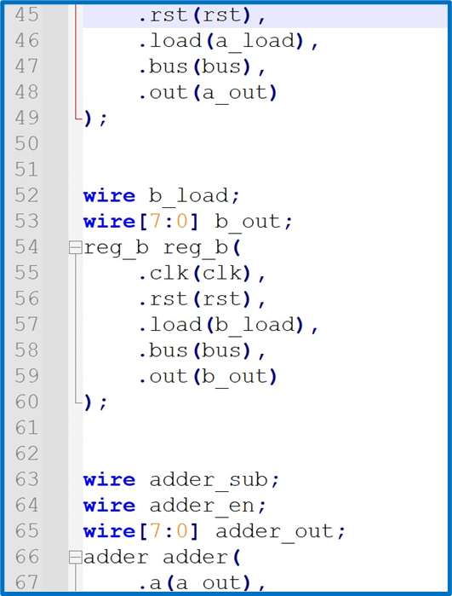
Code:

Slide 37
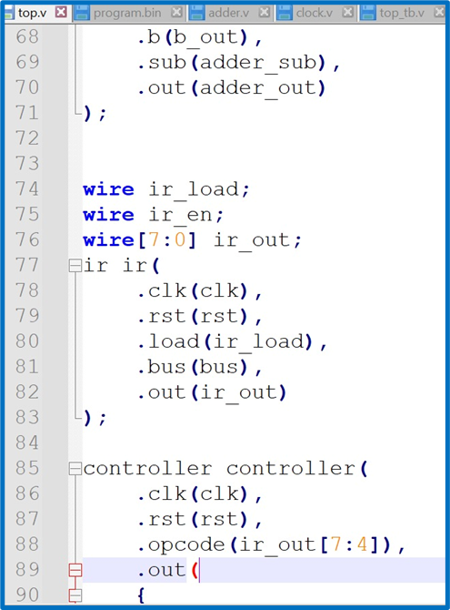
Code:

Slide 38
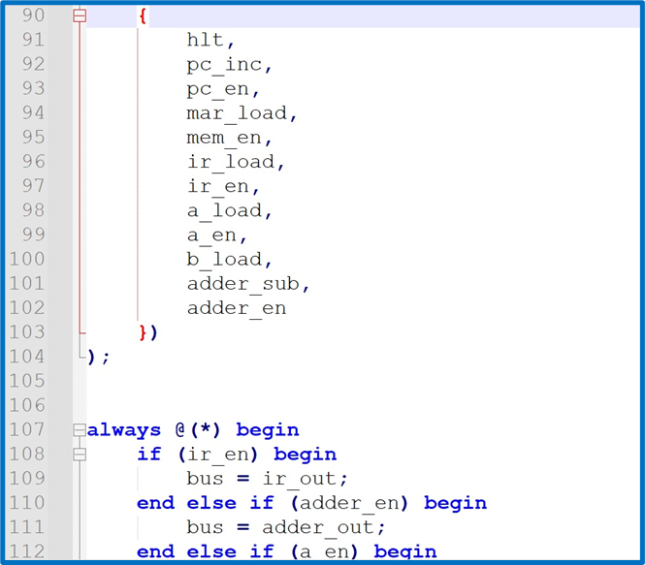
Code:

Slide 39
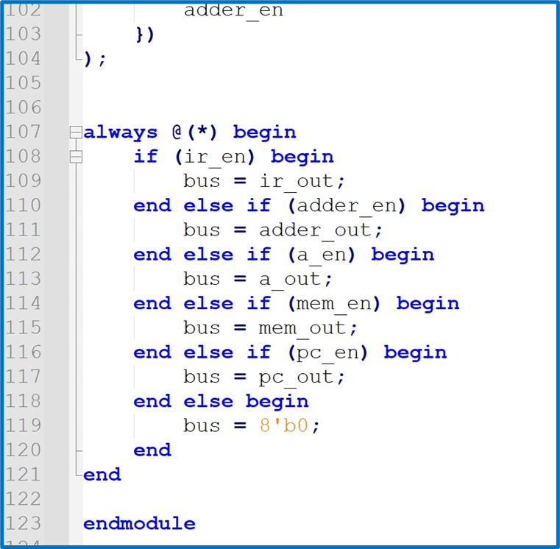
Code:

Slide 40
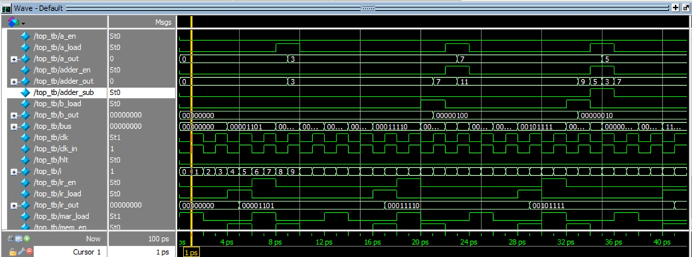
Output:

Slide 41
Conclusion:
The Verilog implementation of the SAP-1 computer is successfully implemented and can be update to SAP-2. The modules work together in a synchronized manner, executing instructions and performing arithmetic operations. This project provides valuable experience in Verilog laying the foundation for more advanced computer architectures.

Slide 42
References:
[1]AUSTIN MORLAN. Building an FPGA Computer: SAP-1. https://austinmorlan.com/posts/fpga_computer_sap1/
[2]ModelSim. Intel.
https://www.intel.com/content/www/us/en/software-kit/750368/modelsim-intel-fpgas-standard-edition-software-version-18-1.html

Slide 43
THANK YOU
FOR YOUR TIME

